Slide 1


Workplace Activity Recognition System

Slide 2
Project Leadership
K Pranay
Data Scientist at AiSPRY
https://www.linkedin.com/in/pranay-k-85756b102/
Avikal Chauhan
Data Scientist Associate at AiSPRY
https://www.linkedin.com/in/avikal-chauhan-665564202/

Slide 3
Team Members
K Praveen Kumar
G Sukesh
Pavan Paradesi
Rajesh
Jagadeesh
Naga Venkat
Srisailam
Ravi
Arundathi
Harikrishnan
Sunoj
/

Slide 4

Contents
Business objective
Business Constraints
Project Architecture
Data collection and details
Exploratory Data Analysis
Visualization
Modeling
Evaluation
Deployment
Notes:
Change

Slide 5
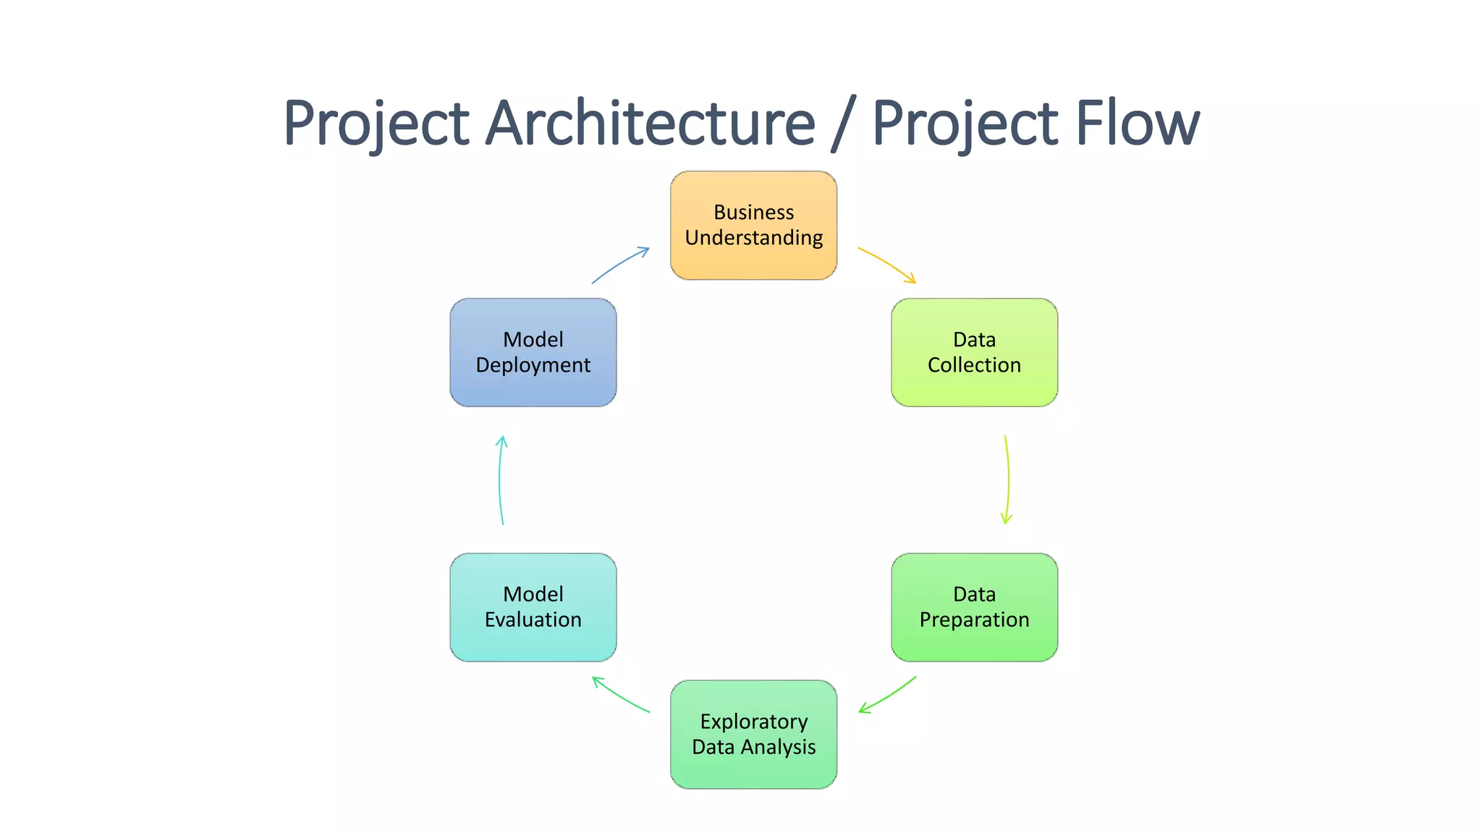
Project Overview and Scope

Slide 6
Business Problem
Employee productivity in the workplace is currently below desired levels, impacting overall efficiency and performance.

Slide 7
Business Objective
Objective
Constraints
Minimize Privacy Intrusion
Maximize Real-Time Productivity Insights

Slide 8
CRISP-ML(Q) Methodology
There are six stages of CRISP-ML(Q) Methodology
1.Business and data understanding
2.Data preparation
3.Model building
4.Model evaluation
5.Model deployment
6.Monitoring and maintenance

Slide 9
Technical Stacks
Programming Language: Python
Deep Learning Framework: Yolo from Ultralytics
Computer Vision Library: OpenCV
Machine Learning Library: Scikit-learn, Matplotlib
Data Annotation Tool: Roboflow
Model Deployment: Streamlit
cd

Slide 10
Data Collection and Understanding
The section titled "Data Collection and Understanding" in a workplace activity recognition system project is crucial for outlining how data is gathered, processed, and analyzed to build a robust mode
The phase "Data Collection and Understanding" in a workplace activity recognition system project is crucial for outlining how data is gathered, processed, and analyzed to build a robust model.
In this project, data collection focuses on capturing various workplace activities to enable accurate recognition and analysis.
Data Source:
Cameras: Video cameras installed in the workplace capture visual data of employees performing various tasks. This data is used for activity recognition.

Slide 11
Data Information
The data used in this project is central to the development and validation of the workplace activity recognition system.
It encompasses a data type of video data collected from CCTV footage to ensure comprehensive coverage of workplace activities.
This section provides a detailed description of the data, its structure, and its relevance to the project.
Data Type: Video data
Data Format: MP4 video fields and extracted key frames stored in a folder structure.
Metadata: Each Video file includes metadata such as duration, framerate, resolution.

Slide 12
System Requirements
Hardware Requirements:
High resolution surveillance Cameras.
Software Requirements:
CPU: Multi-core processor (Intel core i5)
RAM: 16 GB for handling large datasets and concurrent processing.
Storage: 512 SSD for storing raw data, processed data, and models.
GPU: T4 GPU from google colab for training deep learning models.
Network: Wifi - 100mbps) for data transfer.

Slide 13
Data Preprocessing
Data preprocessing is a crucial step in the workplace activity recognition system project, especially when video data is the primary source. Raw video data often contains noise, irrelevant information, and inconsistencies that can hinder the performance of the recognition system.
Preprocessing Steps:
Video Data Loading:
Tools: OpenCV
Process:
Load video files using OpenCV
Convert video files to a common format (e.g., MP4) for consistency.
Frame Extraction:
Tools: OpenCV.
Process:
Extract frames from video files at a fixed interval (we had taken at every 20th frame) to reduce data volume.
Save extracted frames in a structured folder hierarchy (e.g., Video_001/Frame_0001.jpg).

Slide 14
Data Preprocessing
Annotation:
Tools: Roboflow
Process :
Labeling data in the bounding boxes to help machine learning algorithms understand and classify information.
Augmentation:
Tools: Roboflow
Process:
Artificially increase the dataset by generating new copies of existing data using augmentation techniques like Resize, Auto-Adjust Contrast

Slide 15
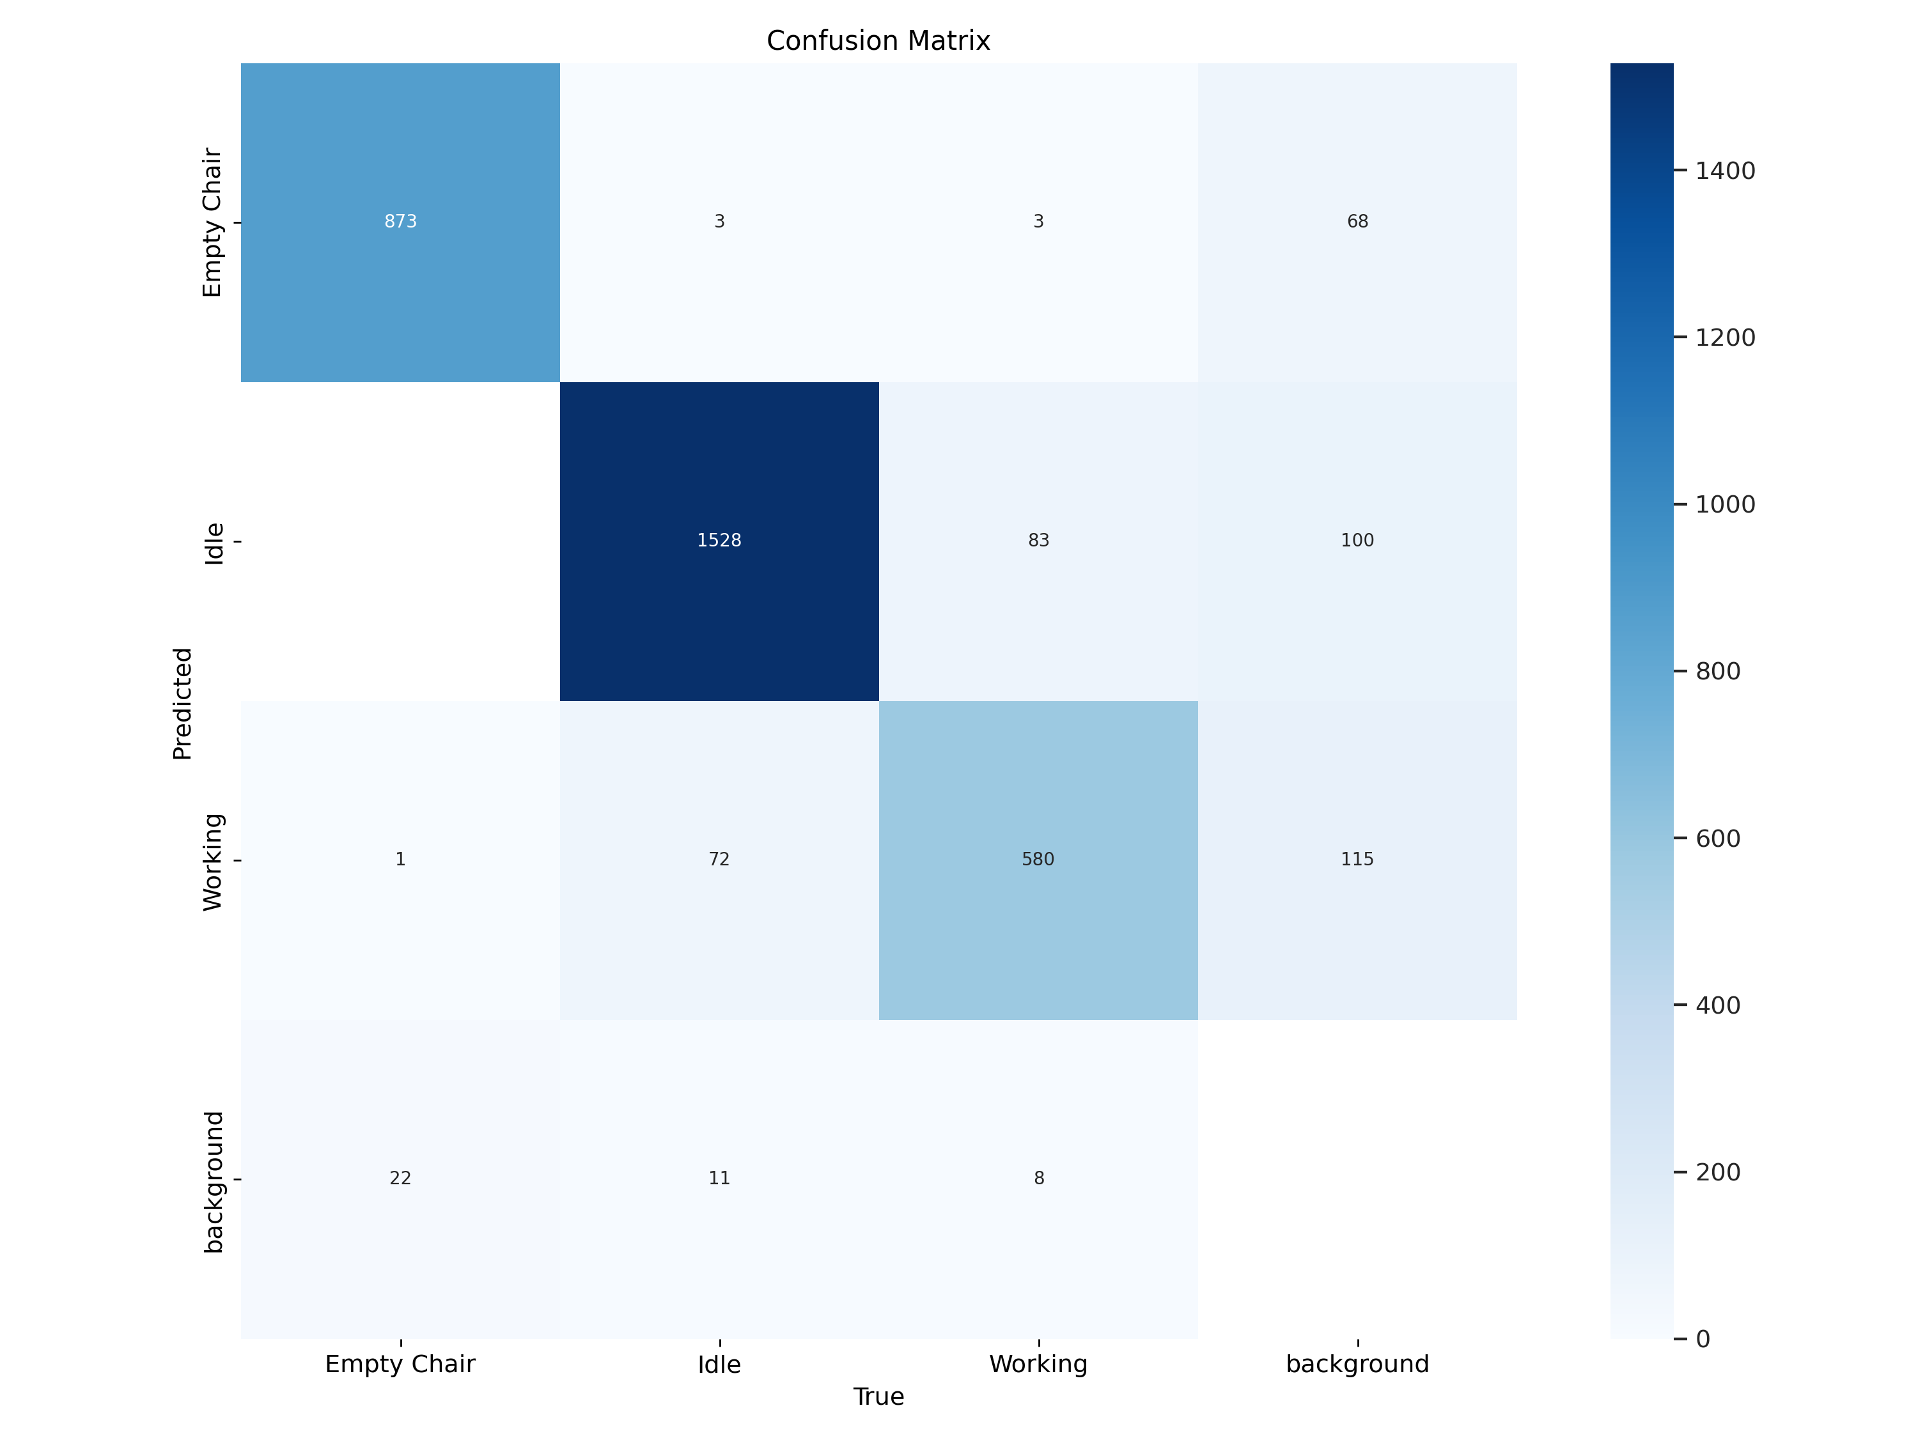
Data Visualization

Slide 16
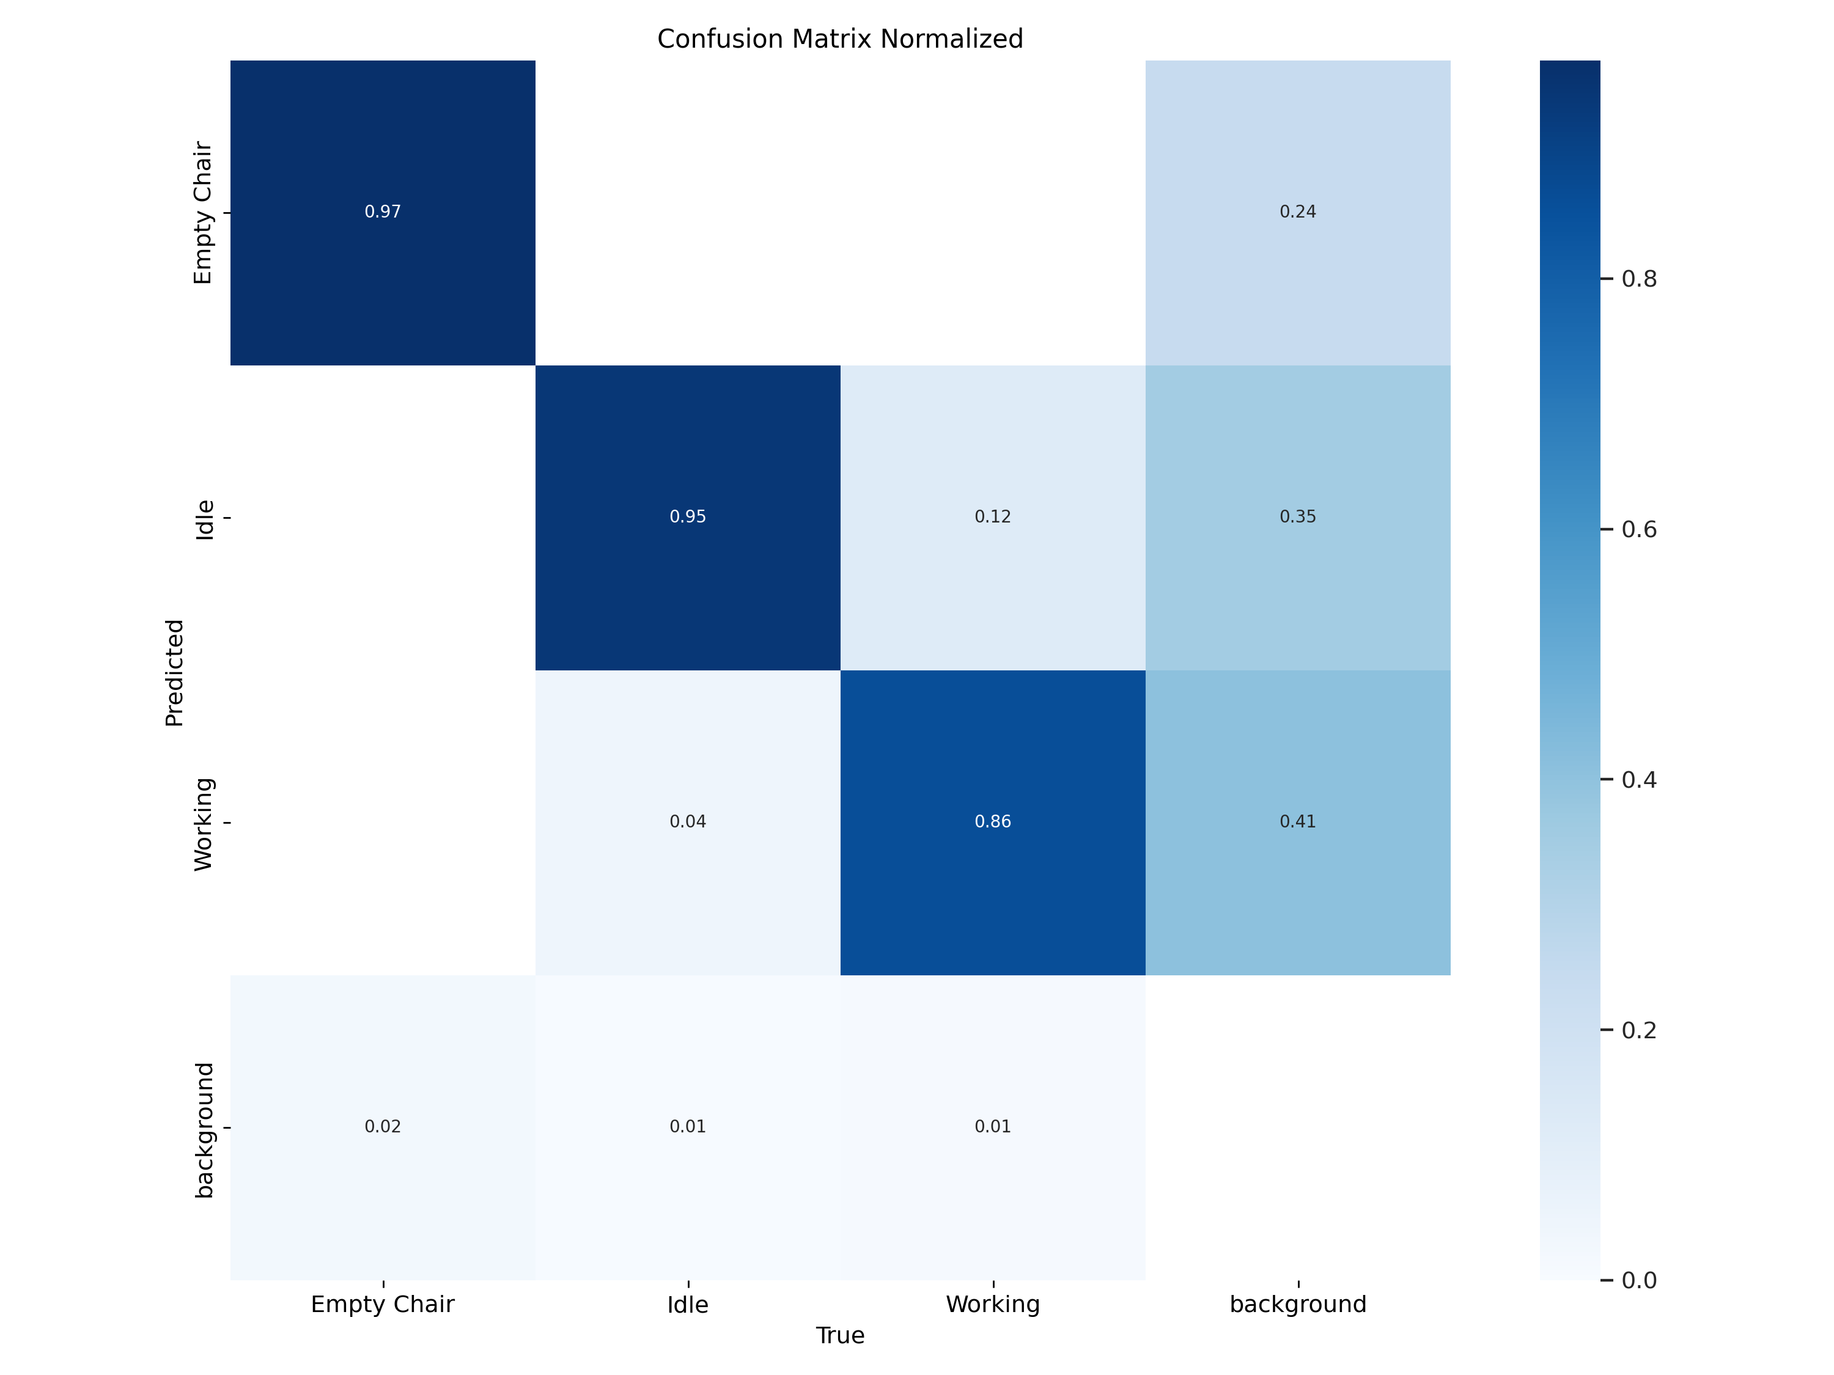
Data Visualization

Slide 17
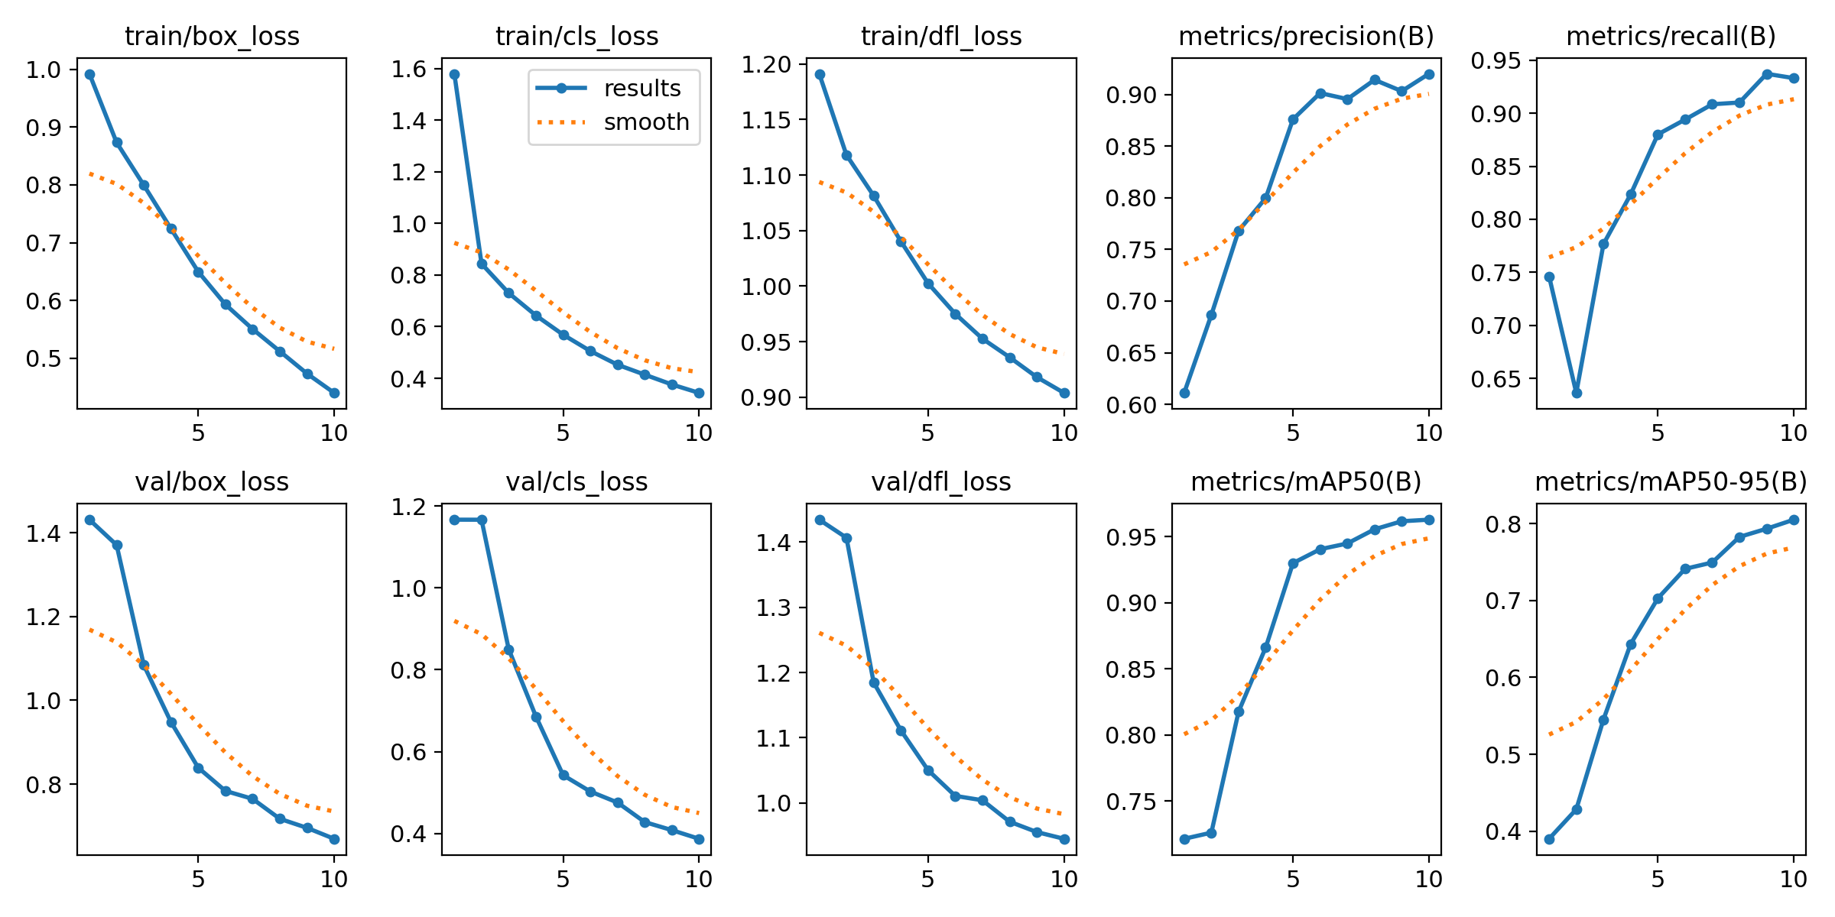
Data Visualization

Slide 18
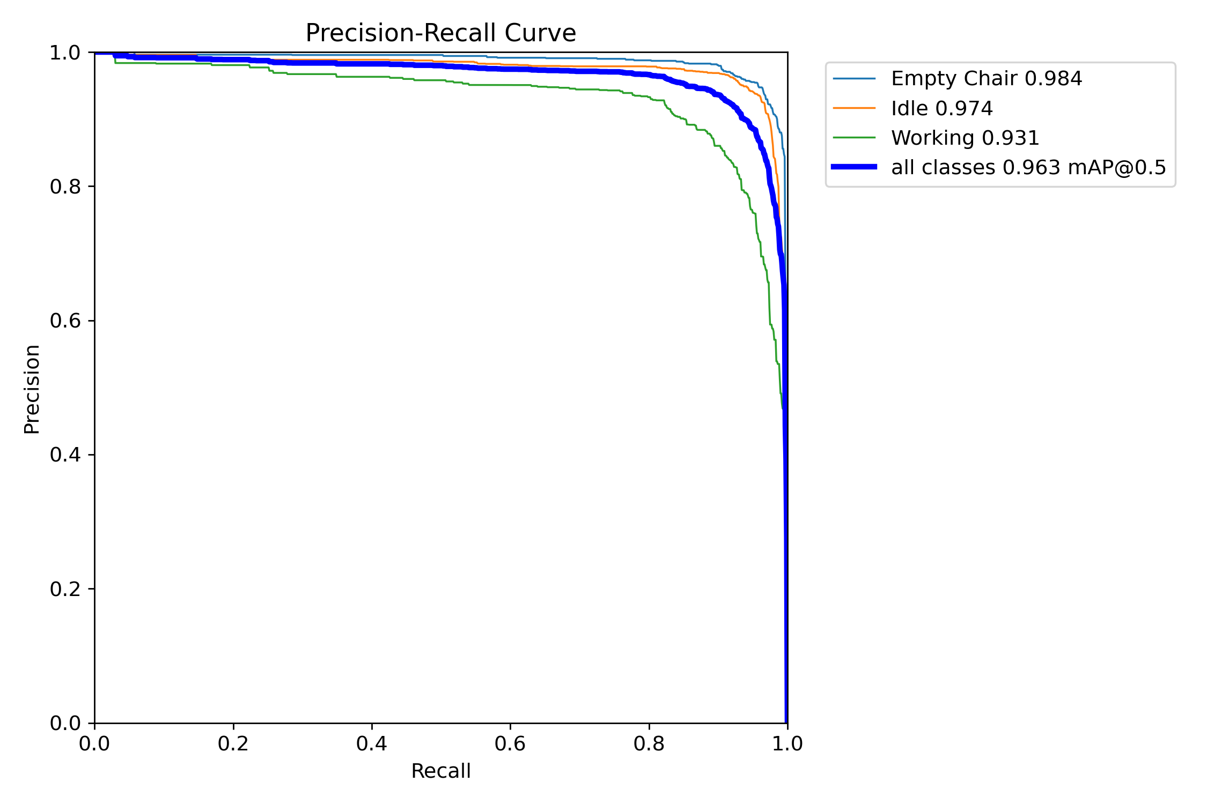
Data Visualization

Slide 19
Model Building
The YOLO (You Only Look Once) models from Ultralytics are state-of-the-art object detection and segmentation models that are widely used for real-time activity recognition tasks.
In workplace activity recognition system project, we have used several variants of YOLO models,
Including
YOLOv8m(medium),
YOLOv8n(nano),
YOLOv8s(small),
YOLO11m(medium),
and YOLO11n(nano).

Slide 20
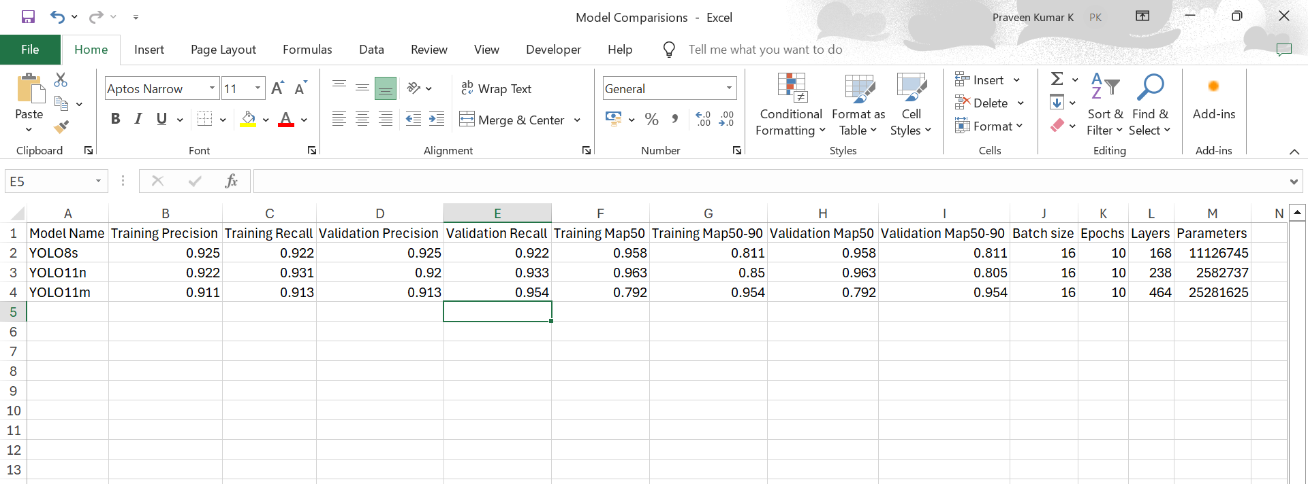
Model Accuracy Comparison

Slide 21
Best Model – Yolo11m
When comparing models like YOLOv11m, YOLOv11n, and YOLOv8s the mAP (mean Average Precision) metric is a key performance indicator. Specifically, mAP50-95 is a widely used metric in object detection tasks, including YOLO models, to evaluate the model's accuracy across different IoU (Intersection over Union) thresholds.
mAP50-95 is the average of AP (Average Precision) values calculated at IoU thresholds ranging from 0.50 to 0.95, in increments of 0.05.
IoU: Measures the overlap between the predicted bounding box and the ground truth bounding box.
mAP50-95: Provides a comprehensive measure of the model's accuracy across a range of IoU thresholds, making it a robust metric for evaluating object detection models.
Higher mAP50-95 indicates better performance, as it means the model is more accurate across a wider range of IoU thresholds.
By comparing, we can say that Yolo11m is the best model.

Slide 22
Model Deployment - Strategy
Model Deployment outlines how the trained machine learning models are deployed and made accessible to end-users.
Streamlit, a popular Python library for building interactive web applications, is used to create a user-friendly interface for the system.
Deployment Architecture:
The deployment architecture consists of the following components:
Model Server: Hosts the trained YOLO models (e.g., YOLOv8m, YOLOv8n, YOLOv8s, YOLOv11m, YOLOv11n) for real-time inference.
Streamlit Application: Provides a user-friendly interface for interacting with the models.
Backend: Handles data processing, model inference, and communication between the Streamlit app and the model server.
Frontend: The Streamlit web interface that users interact with.

Slide 23
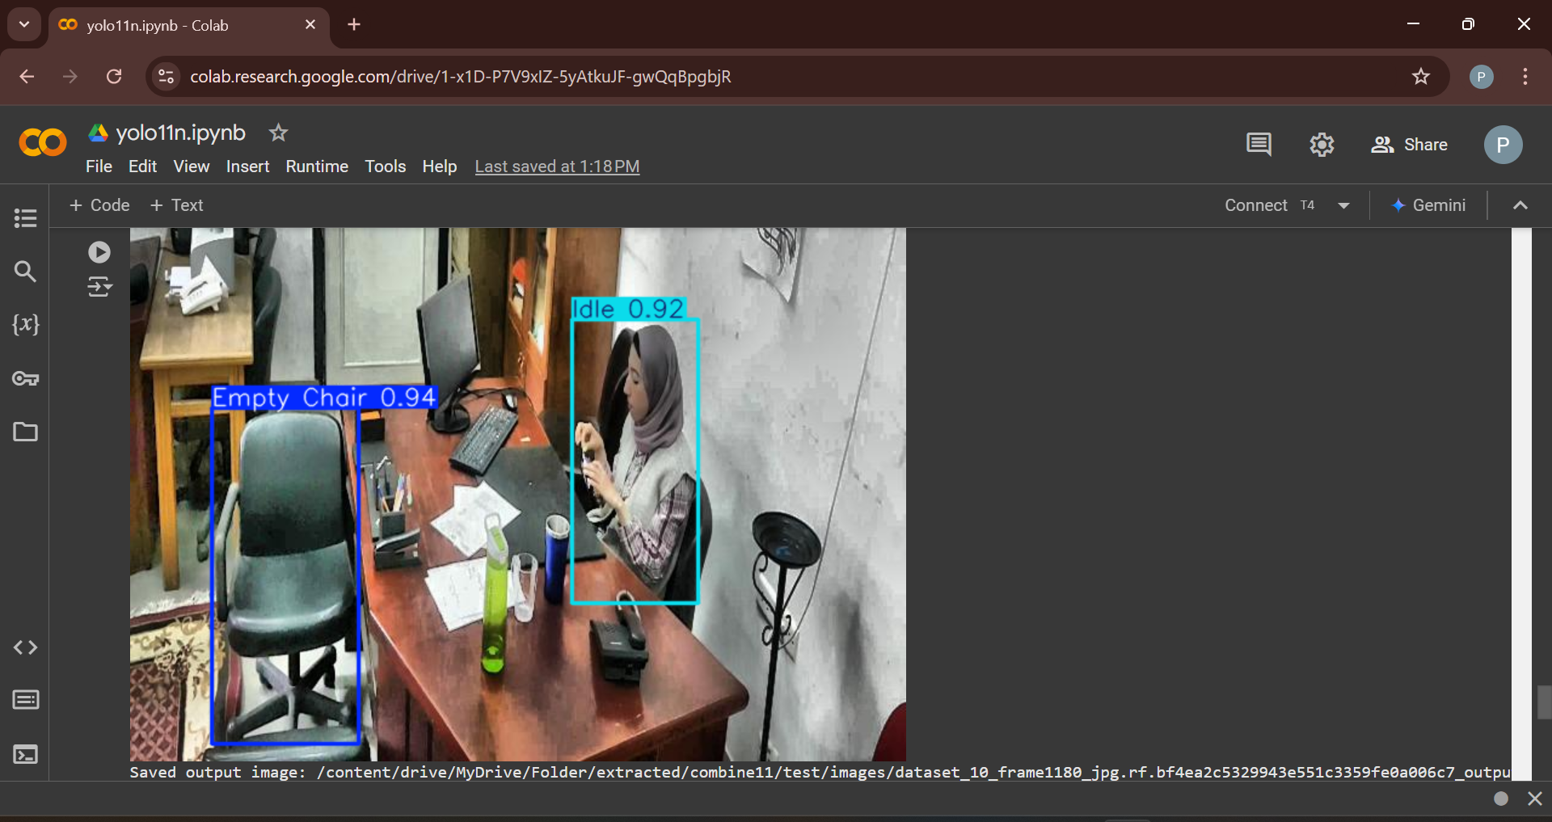
Screen shot of output

Slide 24
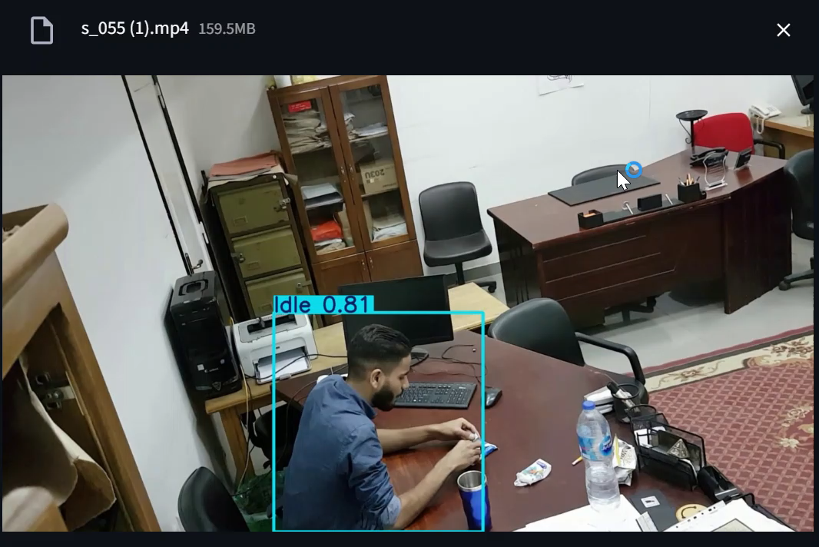
Video of output

Slide 25
Challenges
Developing and deploying a workplace activity recognition system presents several challenges that need to be addressed to ensure the system's success.
Workplace activities are diverse and may vary significantly in terms of duration, context, and complexity. Ensuring that the dataset captures a wide range of activities is crucial for model generalization.
Collecting and processing data from employees raises privacy and ethical concerns. Ensuring compliance with data protection regulations
Some activities may occur less frequently than others, leading to imbalanced datasets that can negatively impact model performance.
Training deep learning models, especially for real-time activity recognition, requires significant computational resources (e.g., GPUs).
Ensuring real-time inference on resource-constrained devices is challenging.

Slide 26
Future Scopes
The workplace activity recognition system has the potential to evolve and expand in various directions to enhance its capabilities, usability, and impact.
Enhanced Activity Recognition:
Integrate additional data sources, such as audio data, environmental sensors, and physiological data from wearables, to provide a more comprehensive understanding of workplace activities.
Develop models capable of recognizing fine-grained activities, such as "typing on a keyboard," "answering a phone call," or "gesturing during a meeting."
Implement real-time feedback and alert systems that notify users or administrators of unusual or potentially hazardous activities.
Integrate with Workplace Management Systems:
Integrate the activity recognition system with HR and payroll systems to automate attendance tracking and performance evaluation.
Use activity recognition to enhance security and access control systems, such as identifying unauthorized access or suspicious behavior.

Slide 27
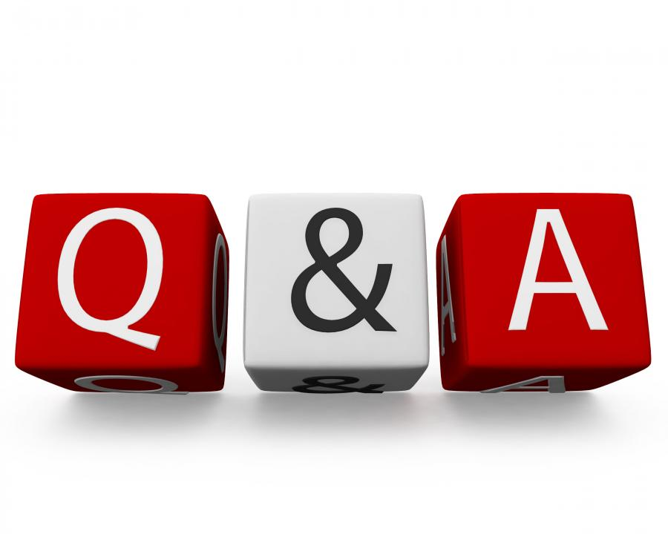
Queries ?

Slide 28


